Slide 1
RGU Hack 2024

Slide 2





Strategic Partner
Notes:
Story;
Access to wider capabilities across Global E&C…

Slide 3
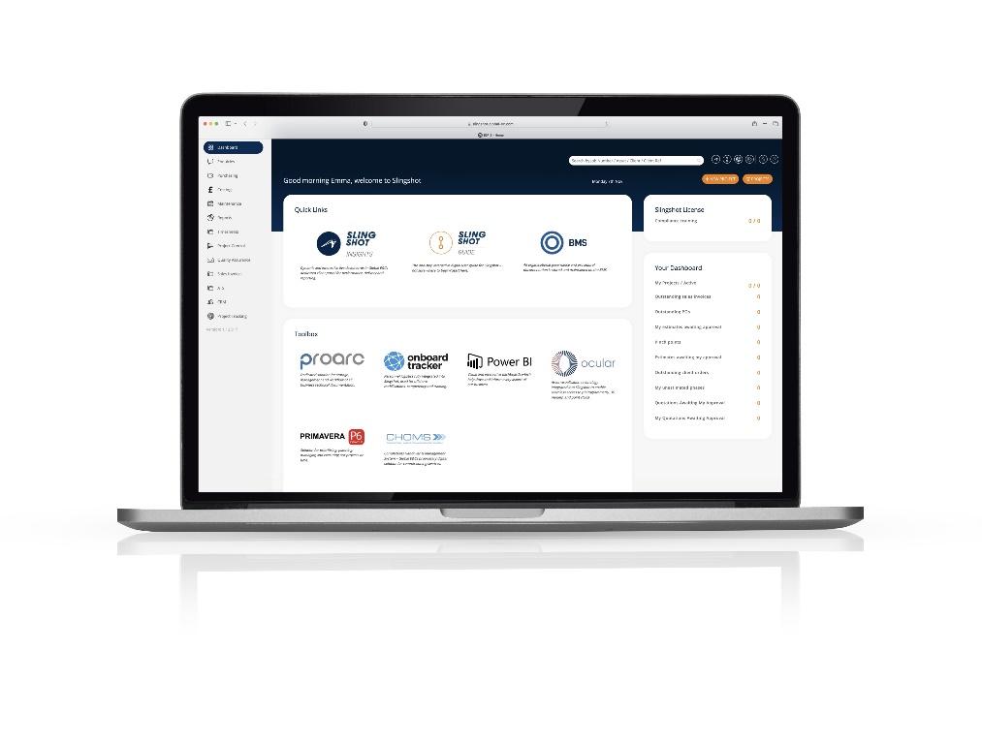
Integrated EPC Delivery Capabilities
Global E&C has the most comprehensive EPC capability in the market. Our range of services and the scope of expertise, positions us to support customers at every stage of their project; from initial concepts to sustaining and enhancing their assets. Our capabilities are enabled and delivered through all of our teams in Global E&C.
Capabilities
SLINGSHOT – EPC MADE DIGITAL

Slide 4


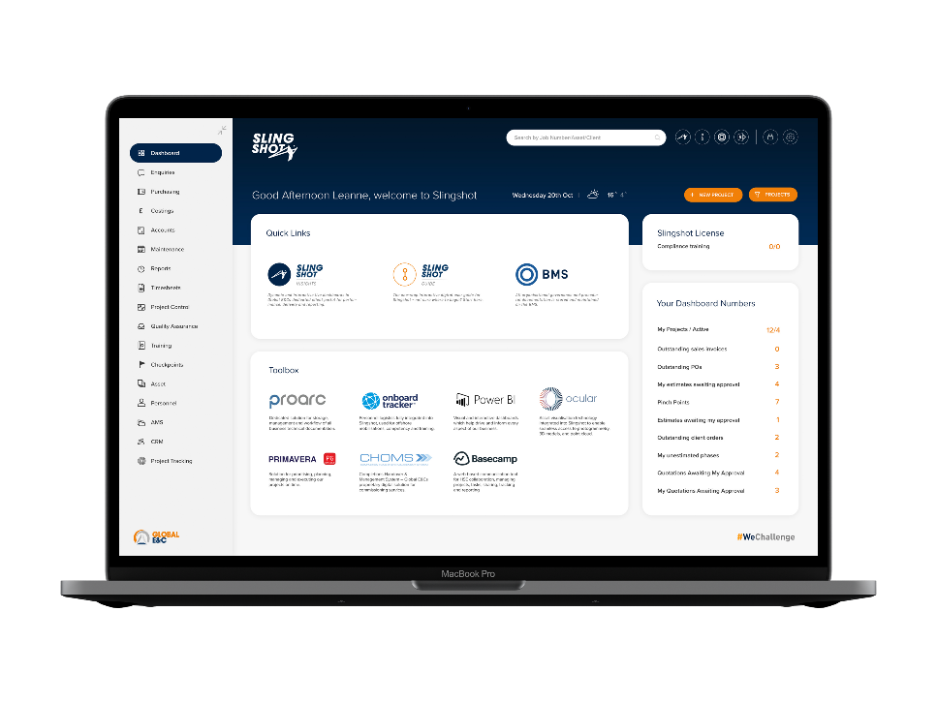








Slingshot - EPC made digital
Dynamic and interactive dashboards in Global E&C’s dedicated customer portal for performance, delivery and reporting.
The one-stop interactive digital user guide for Slingshot. Not sure where to begin? Start here.
All organisational governance and procedural documentation is stored and maintained on the BMS.
Dedicated solution for storage, management and workflow of all business technical documentation.
Personnel logistics fully integrated into Slingshot, used for offshore mobilisations, competency and training.
Visual and interactive dashboards which help drive and inform every aspect of our business.
Asset visualisation technology integrated into Slingshot to enable seamless access to photogrammetry, 3D models, and point cloud.
Solution for prioritising, planning, managing and executing our projects on time.
Completions Handover & Management System – Global E&C’s proprietary digital solution for commissioning services.
We Challenge, Inspire and Deliver.

Slide 5


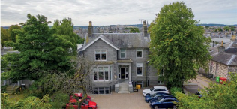
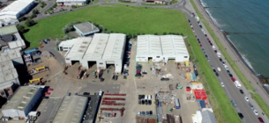
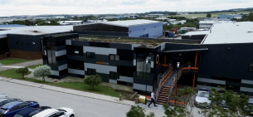
Our Locations
>1500
personnel
Operations
25
offshore
customer assets
Distributed Workshare Centre
Jakarta, Indonesia
& Poland
5
office and workshop facilities
HQ – Projects & Engineering
27 Albyn Place, Aberdeen
Integrated Modular Solution Facility
Nord Centre, York Place, Aberdeen
Brownfield Delivery Facility
MacGregor Building, Howe Moss Place, Aberdeen

Slide 6
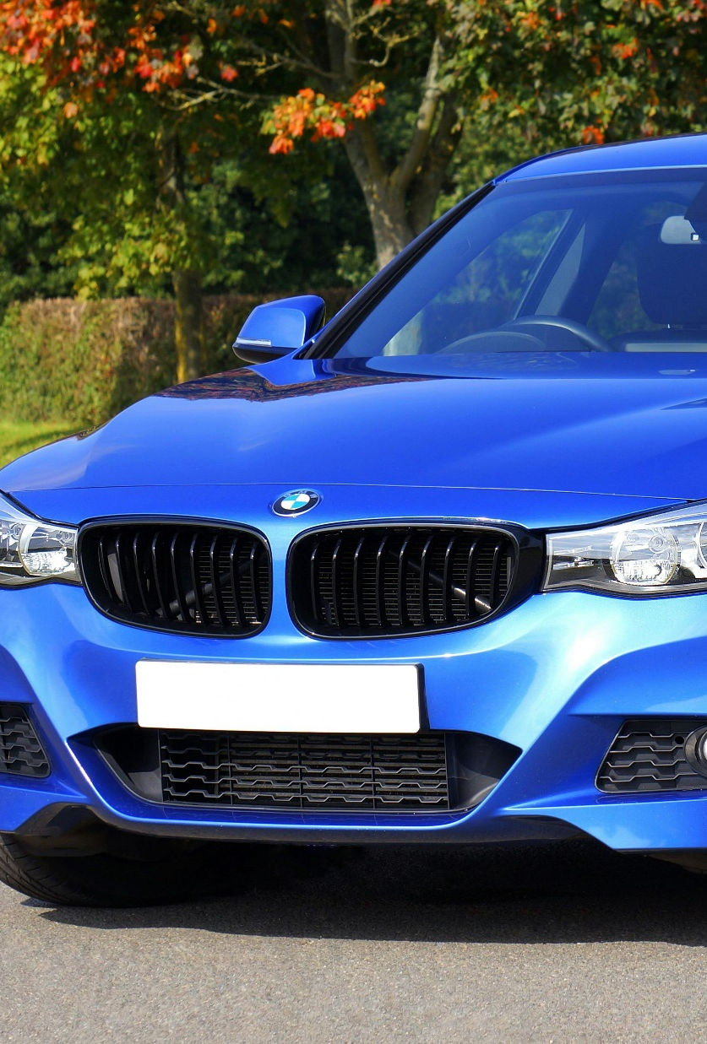
The Challenge
Adam wants to buy his first car but he doesn’t have a lot of money and he is looking for the most cost-effective option on the market.
He is thinking long term and considering not only the cost of buying the car, but also the cost of using it over the course of 5 years.
Help him decide by creating a list of car brand and models with their cost estimates.

Slide 7
The Data
The following data is provided. You should be able to complete the challenge using it:
A collection of datasets with car prices, their tax cost and mpg (miles per gallon) by the car brand and specifications
A dataset with car maintenance costs by the brand, model and year
A look-up table with petrol and diesel costs and Gallon to Litre conversion
Outcomes: Easier Version
Calculate the total estimated cost of buying a car and any costs associated with using it over the course of 5 years.
You should assume that the annual mileage of the car will be 8000 miles.
Display the results for each considered car variation and create recommendations for the cheapest options
Outcomes: More Difficult Version
Calculate the total estimated cost of buying a car and any costs associated with using it taking the annual mileage and period of time (in years) used for the estimate as inputs from the user
Display the results for each consider car variation and create recommendations for the cheapest options
You are free to use Machine Learning, Artificial Intelligence or any other method, as long as you can justify your choice. You are also free to present the results in the form you choose (??)

Slide 8

To access the datasets please scan the following QR code:
https://files.dbuidl.com/uploads/used-car-dataset-challenge.zip
Good Luck!

